Slide 1
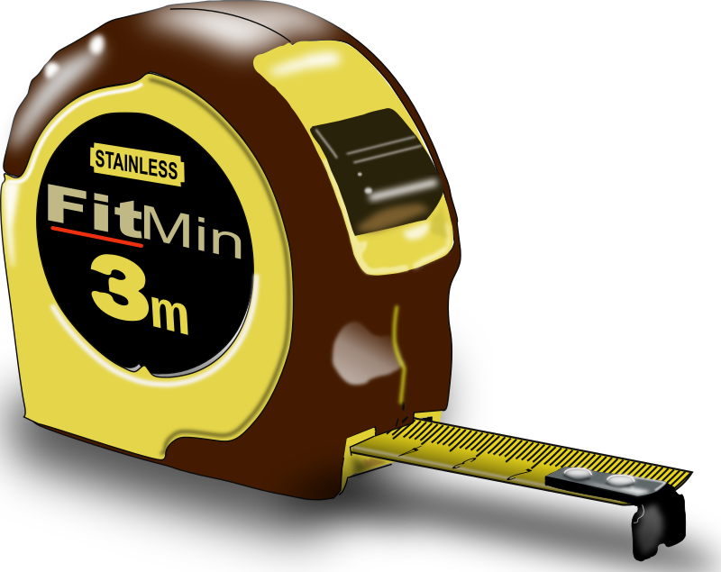
Evaluating Arguments: Determining Viewpoint and Bias
Viewpoint
Bias
Loaded Language
Opinions
Versus Facts
1

Slide 2
Author’s Purpose: “P. I. E.”
The reason or goal for writing or speaking
Persuade:
using a variety of appeals to influence another to accept/join your position or point of view on an issue.
Inform:
to objectively give instructions, compare/contrast, share cause and effects, inform about new information
Entertain:
Using narrative, humor, anecdotes, description, or drama, to amuse, delight, and appeal to imagination
Top Writing Academy™ © 2015

Slide 3
Author’s Viewpoint
The lens through which the author sees their subject. This lens creates author’s perspective, position, opinion, and/or bias within the text
Bias:
Natural tendency to feel a certain way about things
Opinion:
A view or judgment about a subject/issue
In non-fiction writing, author’s purpose and viewpoint are closely related and can be determined by analyzing the use of:
TEXT STRUCTURE LOADED LANGUAGE OPINIONS VS. FACTS
Top Writing Academy™ © 2015

Slide 4
Common Text Structure/Organization
How the text is organized, constructed, or put together for audience
Structure/Organization | Purpose
List or Classification Information to support the main idea is either arranged in a specific order or into specific categories | Typically to inform; however, if listed or categorized by value could be used to persuade
Definition and Example Typically involves one definition context clue, followed by examples to clarify or support the original definition | Used to inform or instruct the audience on new concepts.
Top Writing Academy™ © 2015

Slide 5
Common Text Structure/Organization
How the text is organized, constructed, or put together for audience
Structure/Organization | Purpose
Compare and Contrast Information in the passage contains two or more elements that are compared, contrasted, or both compared and contrasted. | Used for both informing and persuading audiences. Can compare for greater understanding or to persuade that one thing is better than another
Cause-Effect Information in the passage explains the relationship between a cause and the resulting effects. | Typically to inform; however, can be used to persuade one to make choices or take actions that would serve as causes toward a desired effect.
Top Writing Academy™ © 2015

Slide 6
Common Text Structure/Organization
How the text is organized, constructed, or put together for audience
Structure/Organization | Purpose
Problem-Solution Information in the passage explores a problem and the actual or potential solutions to the problem. | Used for both informing and persuading audiences. If the solution is predetermined, it most likely is informative; if there are multiple possibly solutions could be persuasive.
Counter-Argument/Rebuttal Information in the passage presents debatable issue , first discussing the opposition’s argument and then confronting weakness in opponent’s position in a rebuttal argument. | Used to argue and persuade the audience to accept the writer’s position or viewpoint.
Top Writing Academy™ © 2015

Slide 7
Common Text Structure/Organization
How the text is organized, constructed, or put together for audience
Structure/Organization | Purpose
Premise/Support/Conclusion Providing a statement or proposition with supporting evidence followed by the logical conclusion | Mostly used to argue or persuade.
Narrative/Anecdotal Stories or short accounts involving characters, conflict, dialogue, etc | Mostly used to entertain
Top Writing Academy™ © 2015

Slide 8
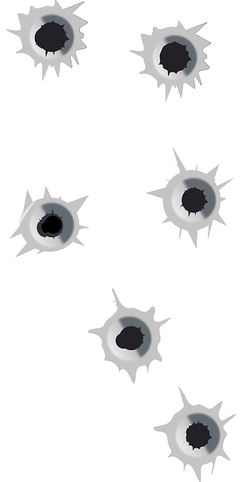
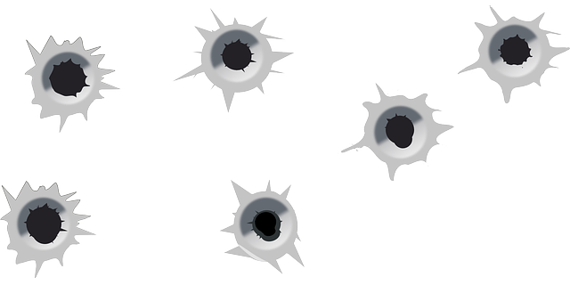
Loaded Language/Words
Powerful words and phrases that reveal the viewpoint or opinion of the author. Loaded words are often used to inspire a certain response (pos. or neg.) within the audience.
Top Writing Academy™ © 2015

Slide 9
Use of Facts vs. Opinion
The author’s viewpoint is often revealed through their use or omission of certain facts, and how the balance between use of facts and opinions.
Fact: a specific detail that
is true based on objective
proof
Opinion: a personal
value or judgment
Top Writing Academy™ © 2015

Slide 10
Use of Facts vs. Opinion
The author’s viewpoint is often revealed through their use or omission of certain facts, and how the balance between use of facts and opinions.
IDENTIFYING FACTS AND OPINIONS
FACT | OPINION
Is objective Is discovered States Reality Can be verified Presented without biased words Example: An orange is citrus. | Is subjective Is created Interprets Reality Cannot be verified Presented with biased words Example: An orange tastes great
Top Writing Academy™ © 2015

Slide 11
Use of Facts vs. Opinion
The author’s viewpoint is often revealed through their use or omission of certain facts, and how the balance between use of facts and opinions.
WORDS THAT INDICATE BIAS/OPINION (Adj./Adv. That express value/judgment/interpretation)
Awful Amazing Bad Beautiful | Best Better Disgusting Exciting | Favorite Frightful Fun Good | Great Handsome Horrible Miserable | More Most Smart Stupid | Terrible Unbelievable Ugly very
Top Writing Academy™ © 2015

Slide 12
Use of Facts vs. Opinion
The author’s viewpoint is often revealed through their use or omission of certain facts, and how the balance between use of facts and opinions.
WORDS THAT QUALIFY POSITIONS OR BELIEFS
All Always Appear Believe | Could Every Has have to It is believed | Likely May Might Must | Never Often Only Ought to | Possibly Possible Probably Seem | Should Sometimes Think usually
Top Writing Academy™ © 2015

